Slide 1


TNT Quantification Model
BTech project
Supervisor : Dr. Sushmita Jha

Slide 2
Timeline
Circularity and Compactness model : Scoring for fast and feasible process
Tunneling Nanotubes Quantification Model
Optimising the results using different image augmentation processes.
August
October
December
September
November
Area calculation using ImageJ to see and analyse the area and progress of spheroids.
Platform development where the model and dataset will be available for future access.

Slide 3
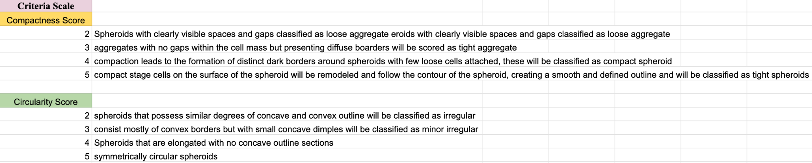
Circularity and Compactness Model
Predictive model for scoring - Circularity and compactness are geometric features that can be calculated to describe the shape of objects, such as breast cancer spheroids in medical images. Features can be useful in developing deep learning models for breast cancer detection or classification.
What we did :
- Preparing the dataset
- Splitting the dataset
- Preprocessing the images
- Defining the model architecture
- Training the model
- Tuning the hyperparameters
- Evaluating the parameters
- Using the model

Slide 4
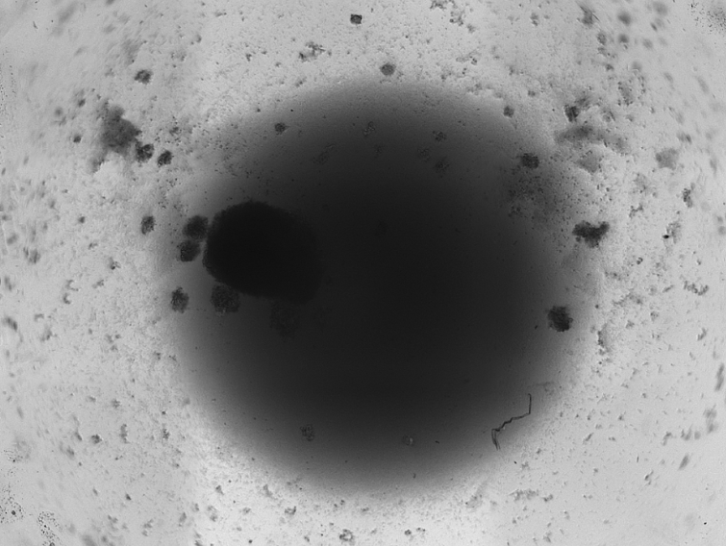
Results
Model :
Calculates the circularity and compactness score based
On the basis of scoring table provided.
Why is it important?
Incorporating circularity and compactness calculations into deep learning models for breast cancer spheroids can improve the accuracy and reliability of cancer detection and classification. These measures contribute to a more thorough and quantitative analysis of medical images, ultimately benefiting patient outcomes and advancing medical research.

Slide 5
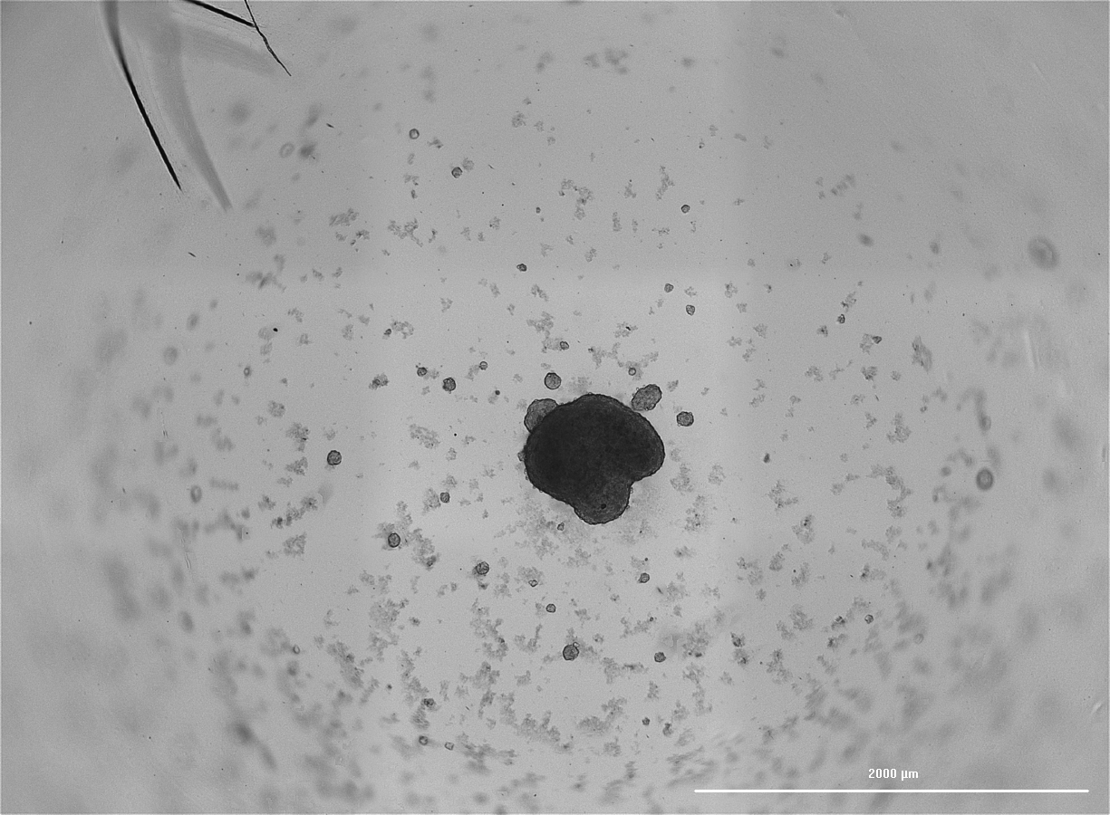
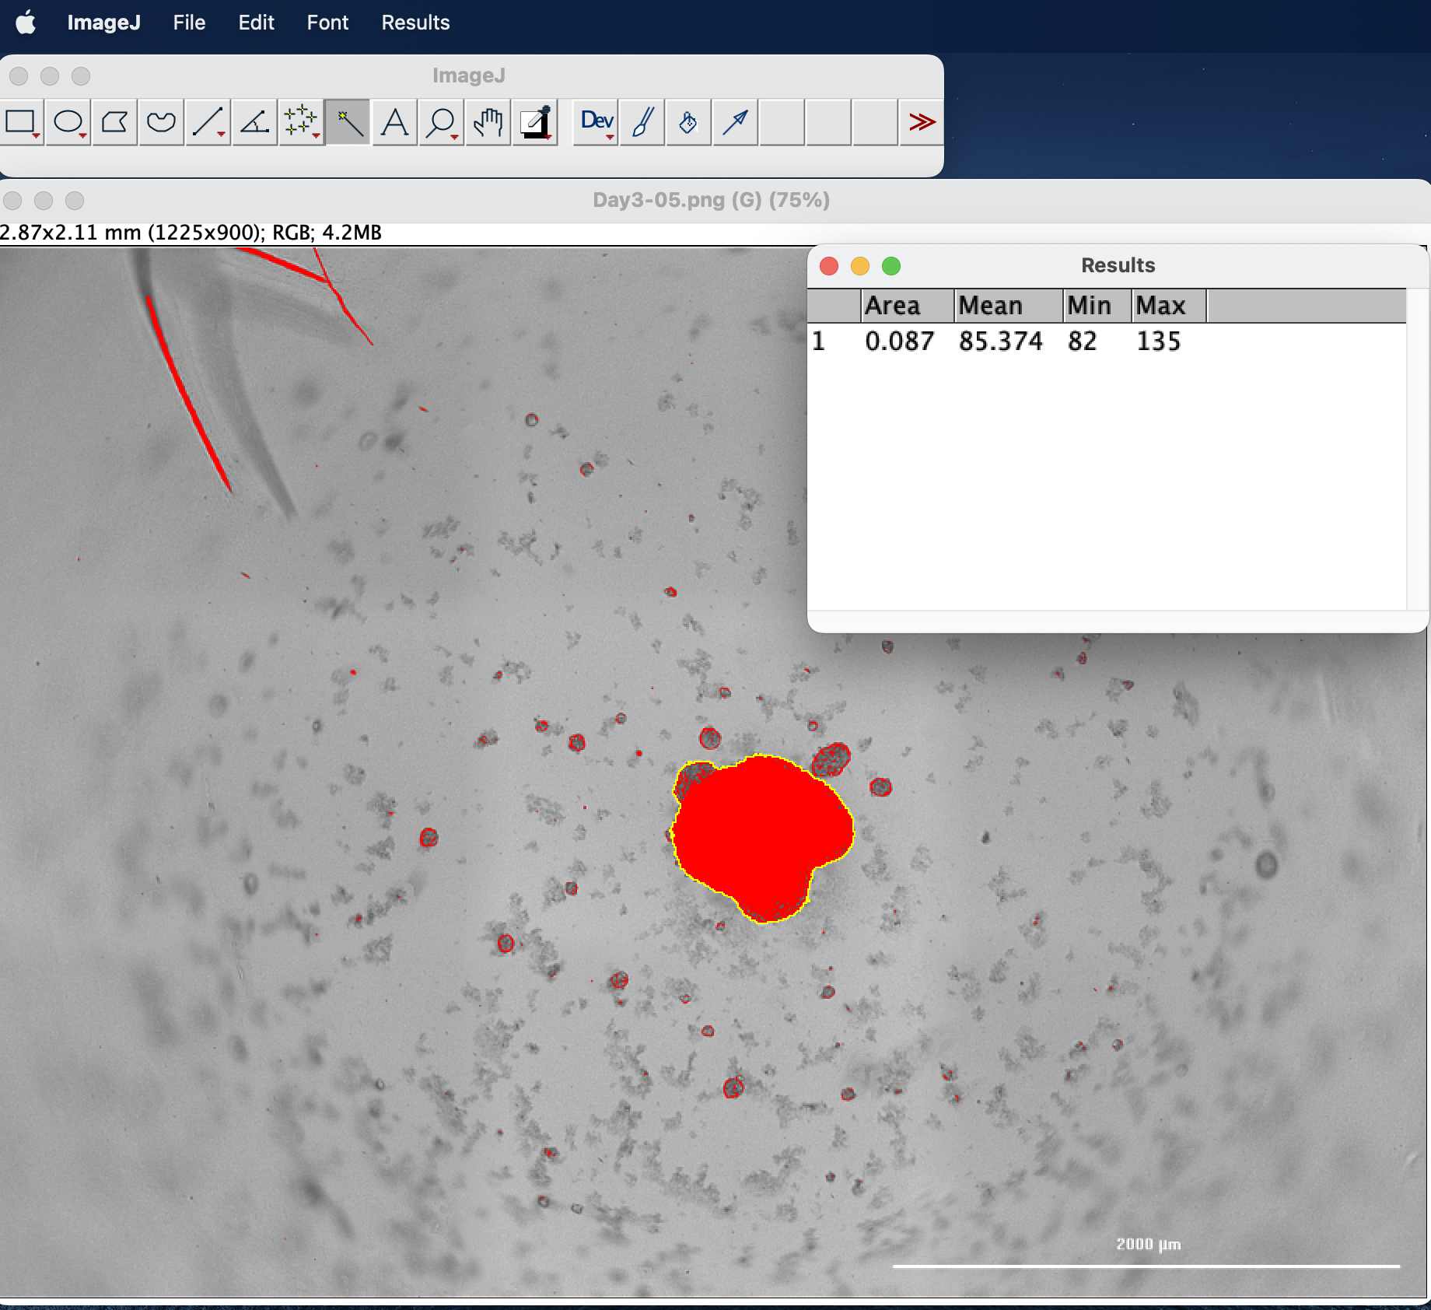
Area Calculation : ImageJ
ImageJ is a powerful open-source image processing software that can be used for various tasks, including calculating the area of objects in an image.
Steps followed for calculating area :
Setting Scale
Selecting Region of Interest (ROI)
Adjusting measurements
Measuring the area
Results
Notes:
Set Scale (if applicable):
If your image has a known scale, you should set it to convert pixel measurements to physical units. Go to Analyse > Set Scale and enter the appropriate values.
Select Region of Interest (ROI):
Use the selection tools (e.g., rectangle, oval, freehand) to draw a region of interest around the object whose area you want to measure.
Check or Adjust Measurement Settings:
Go to Analyse > Set Measurements to make sure that "Area" is selected. You can also choose other parameters you want to measure, such as perimeter, mean intensity, etc.
Measure the Area:
With the ROI selected, go to Analyse > Measure or simply press Ctrl + M (Windows) or Command + M (Mac). The measurement results will appear in the "Results" window.

Slide 6
Table of contents
01.
Objectives
03.
Results Analysis
02.
Methodology
04.
Conclusions

Slide 7
01.
Objectives
TNT Quantification

Slide 8
TNTs - long, thin membranous structures that form between cells, enabling direct communication and transfer of various cellular components
Potential role in cancer progression and communication between cancer cells
TNT Quantification WHYYY??
Insights into the intercellular communication within the tumor microenvironment
To assess the likelihood of tumor cell spread

Slide 9
02.
Methodology
TNT Quantification

Slide 10
Characteristics of TNTs
Thin and tubular structures
TNTs are typically thin, elongated, and tubular structures that form bridges between cells
Membrane connections
TNTs establish direct membrane connections between cells, allowing for the transfer of cellular components, such as organelles, vesicles, and signaling molecules
Heterogeneity
TNTs in breast cancer cells may exhibit heterogeneity in terms of length, thickness, and dynamics. This variability could be influenced by the specific subtype of breast cancer or other factors
Dynamic nature
TNTs can be dynamic, forming and retracting over time. Live-cell imaging may be necessary to capture the dynamic behavior of TNTs in breast/brain cancer cells

Slide 11
Parameters of TNT identification
Microscopy technique
Connection between cells
Image pre-processing
Dynamic nature
Focus on thin structures
Cell type and context
Length and thickness

Slide 12
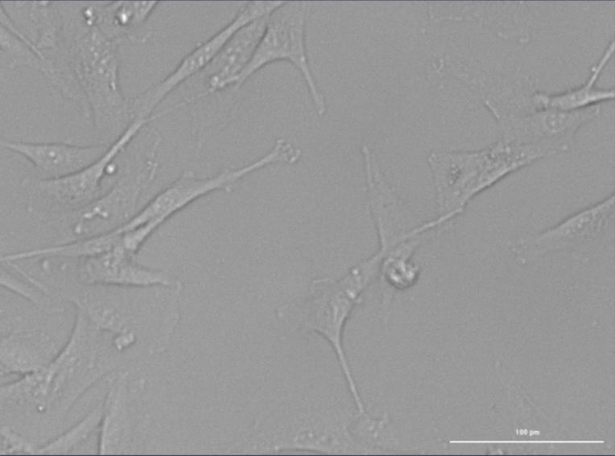
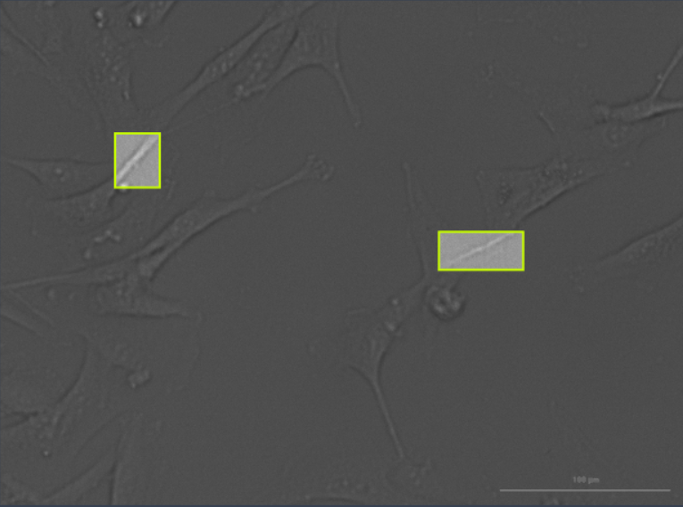
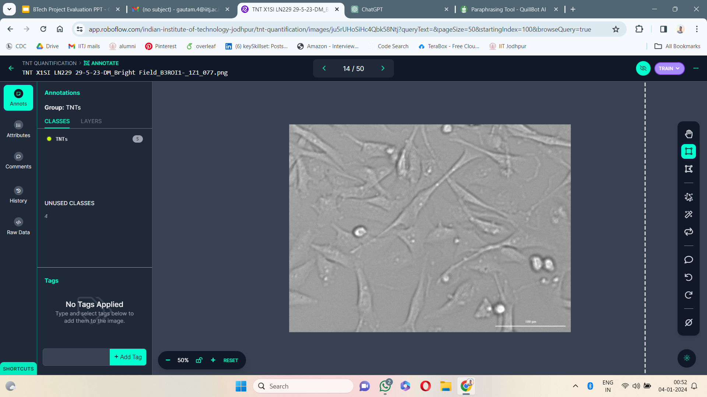
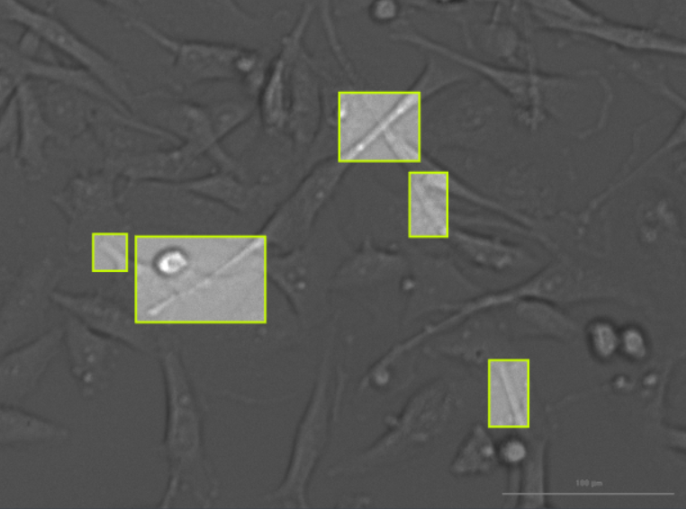
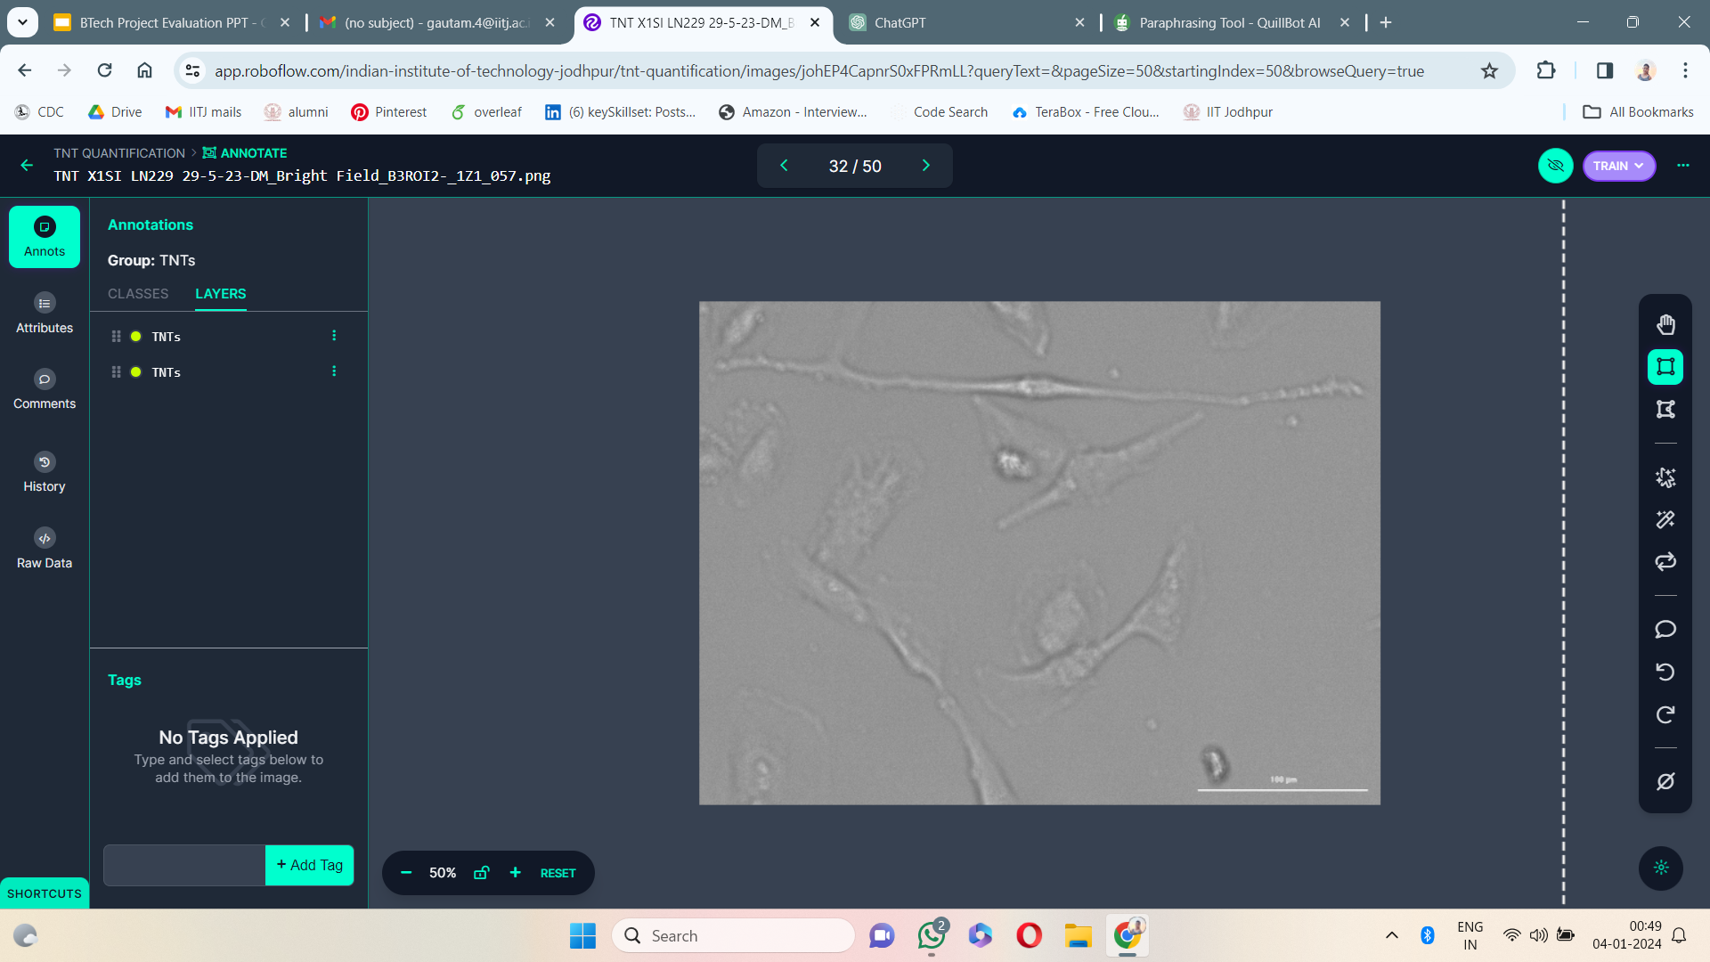
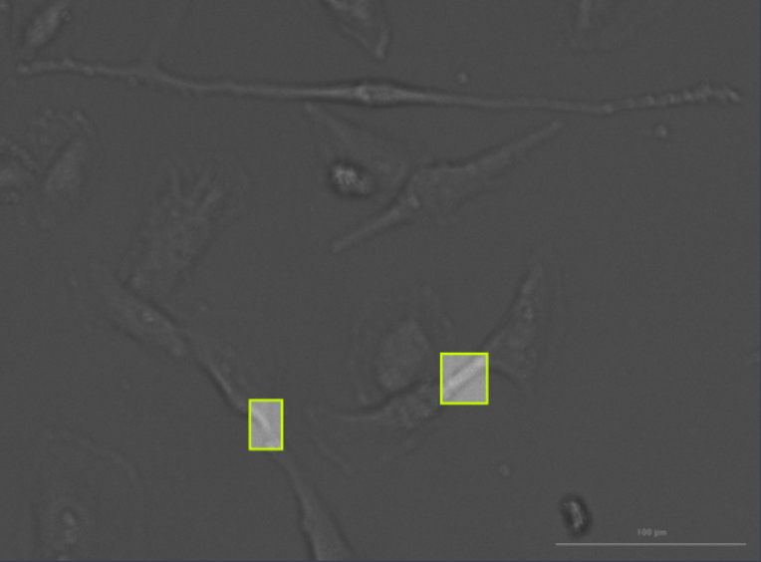
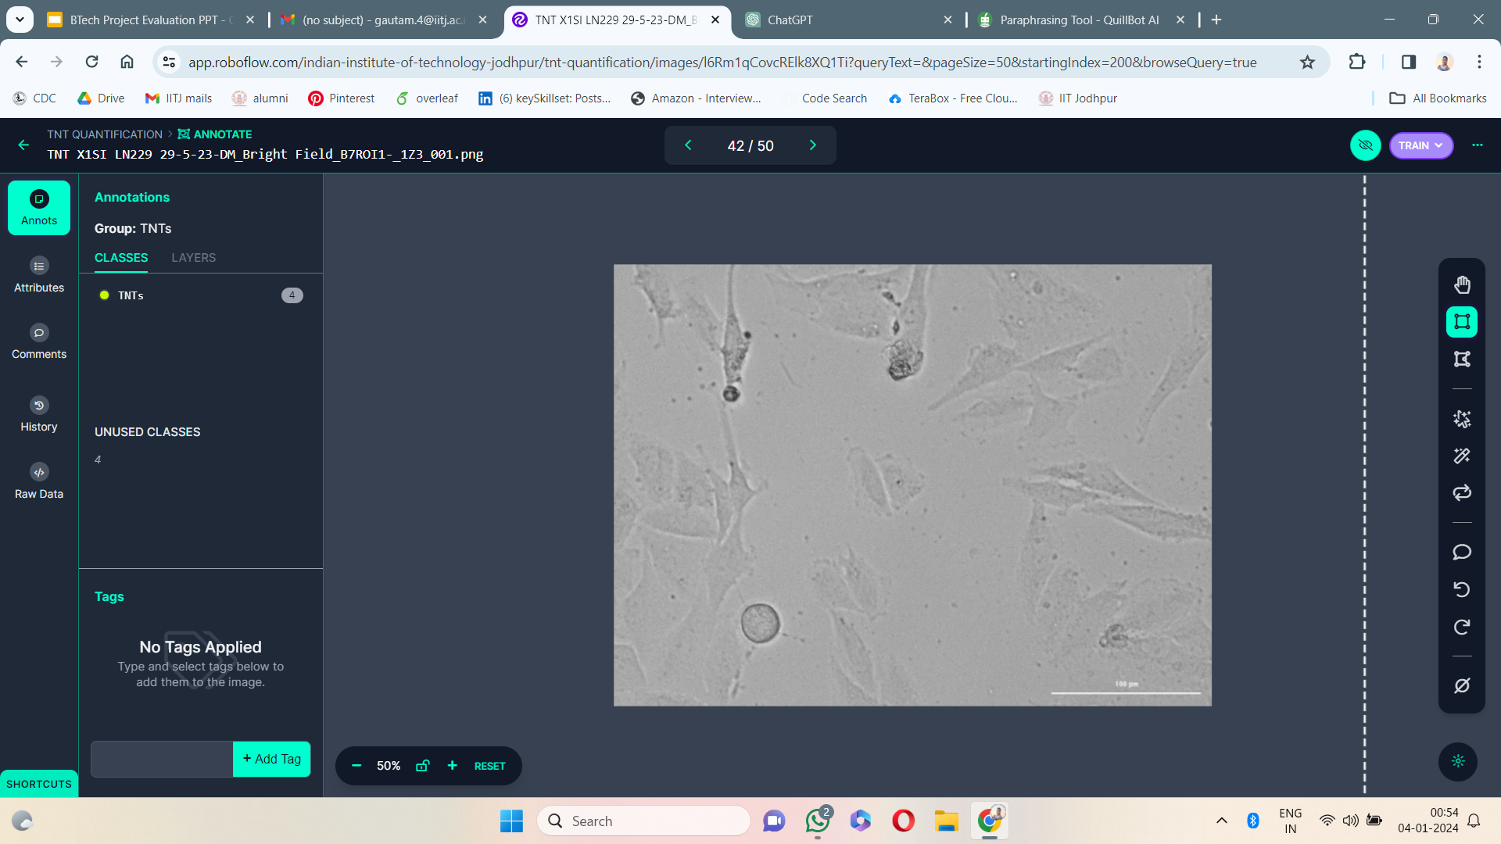
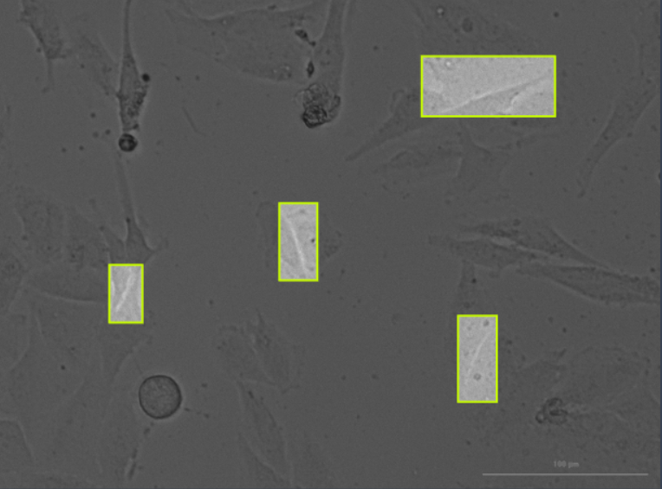
Image processing
Before After Before After

Slide 13
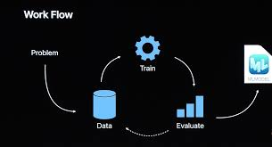
About Our Model

Slide 14
About Our Model
Dataset :
Train set
198 Images
Validate set
98 Images
Test set
22 Images
Result :
mAP
~ 14 %
Precision
~ 40 %
Recall
~ 18 %

Slide 15
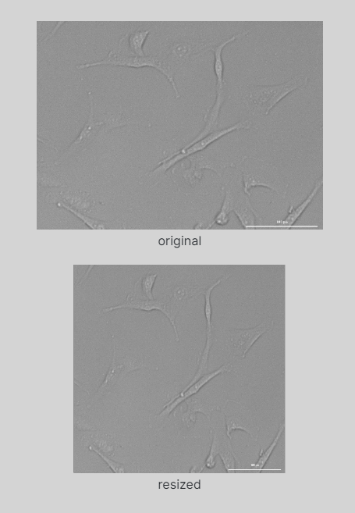
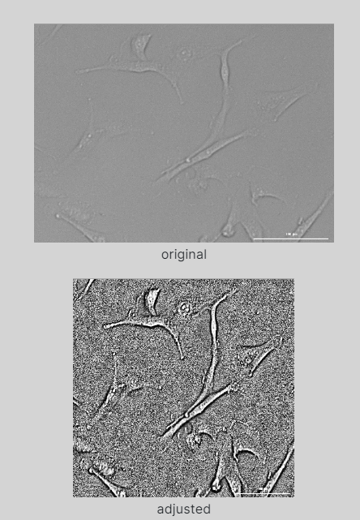
Resize Contrast
Downsize images for smaller file sizes and faster training.
Boosting contrast based on the image's histogram to improve normalization and line detection in varying lighting conditions.

Slide 16
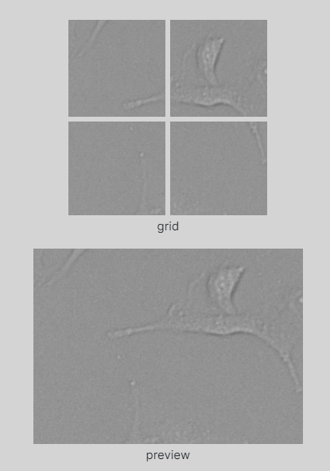
Tile
Splitting images into tiles to improve the accuracy on small objects.
2 x 2

Slide 17
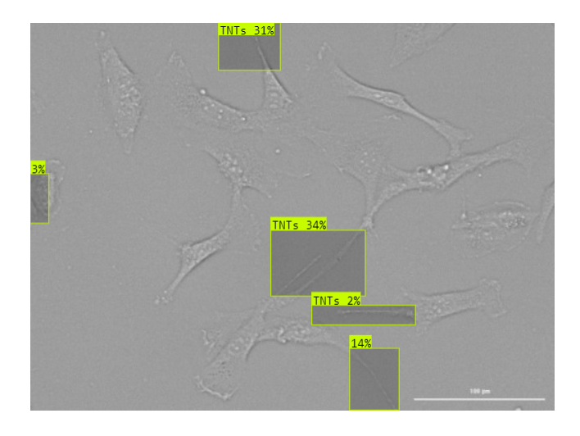
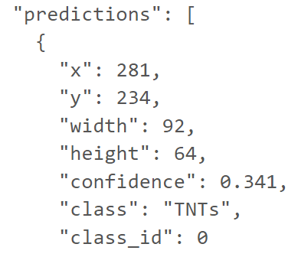

Slide 18
An example of TNT Prediction in an image

Slide 19
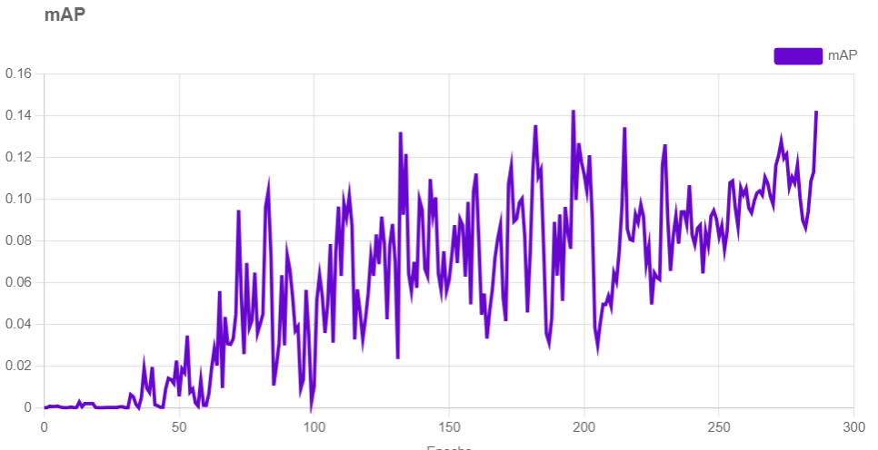
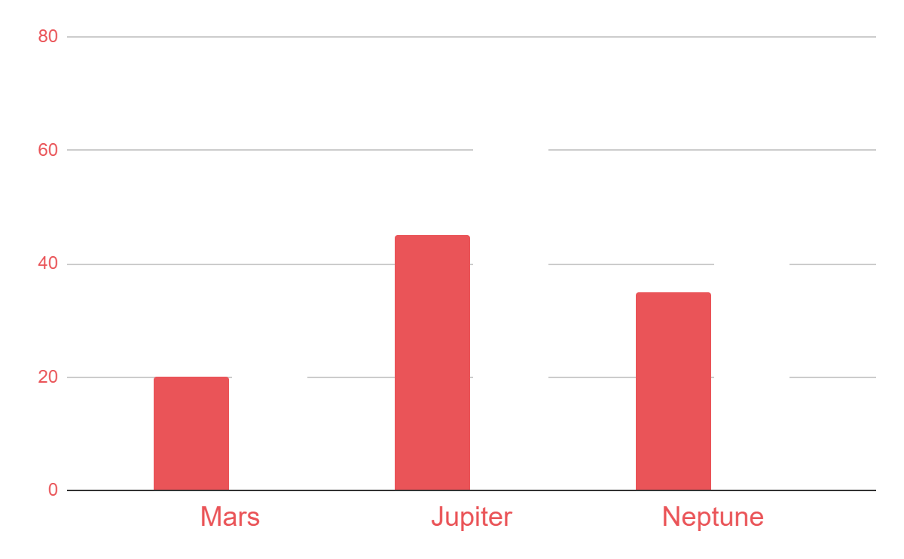
Results analysis
20%
25%
45%
65%
35%
45%
To modify this graph, click on it, follow the link, change the data and paste the resulting graph here, replacing this one

Slide 20
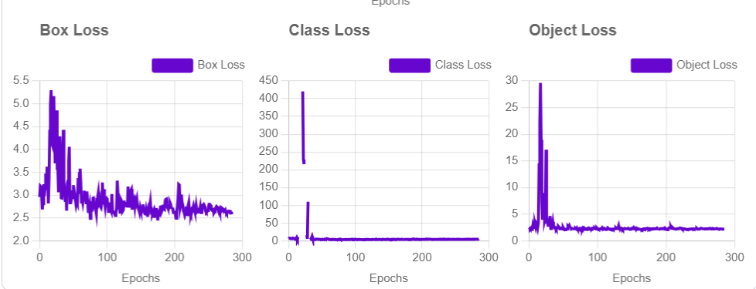
Results analysis
20%
25%
45%
65%
35%
45%
To modify this graph, click on it, follow the link, change the data and paste the resulting graph here, replacing this one

Slide 21
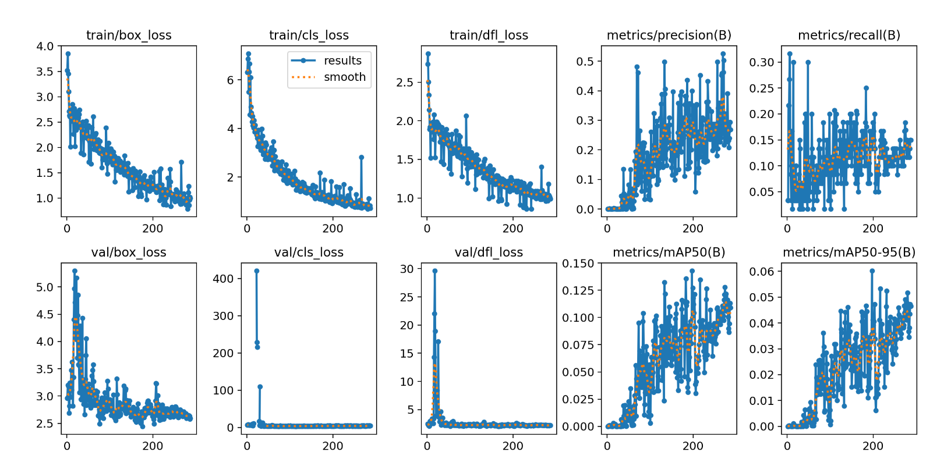
Results analysis
20%
25%
45%
65%
35%
45%
To modify this graph, click on it, follow the link, change the data and paste the resulting graph here, replacing this one

Slide 22
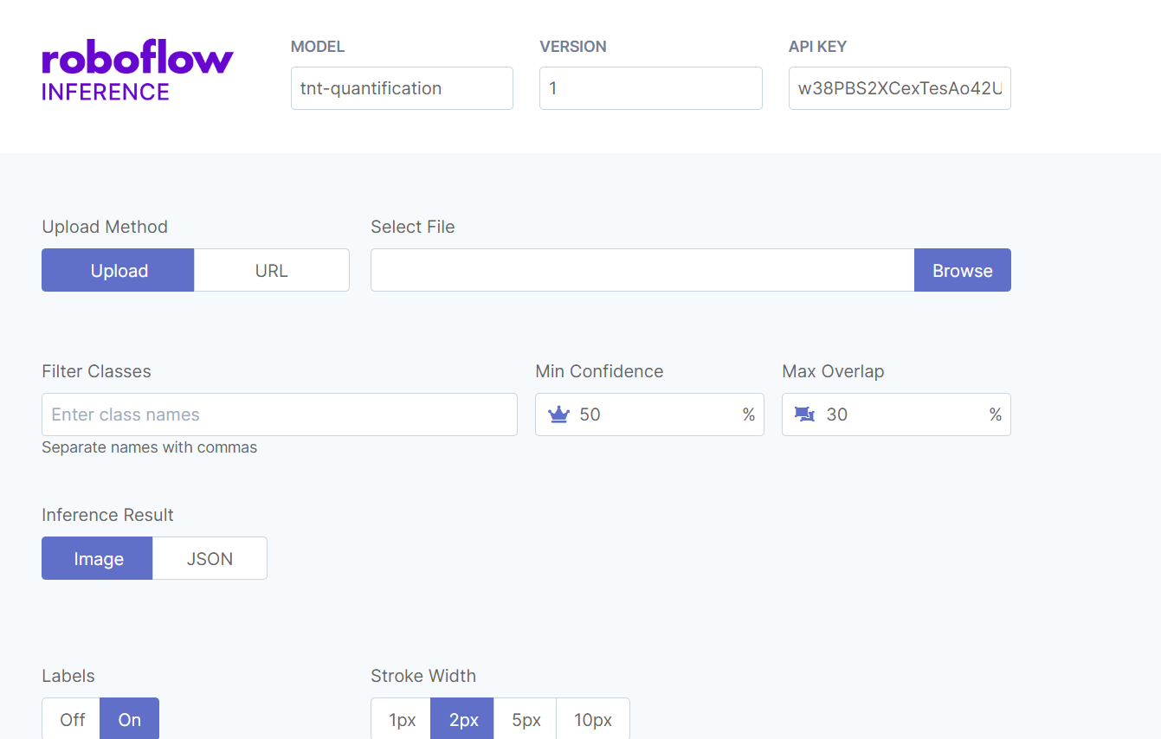
Interface

Slide 23
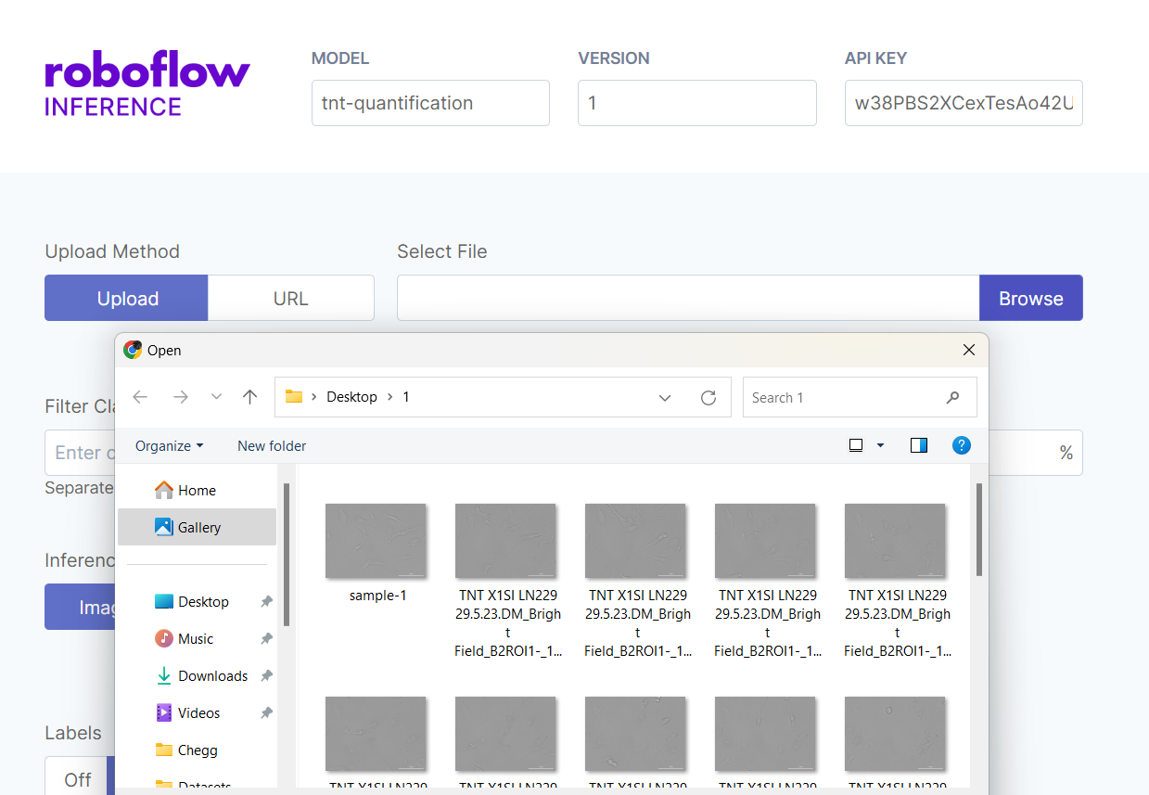
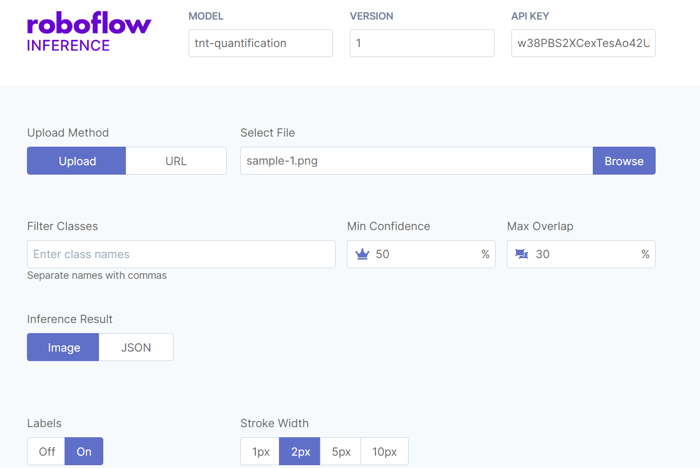
Interface

Slide 24
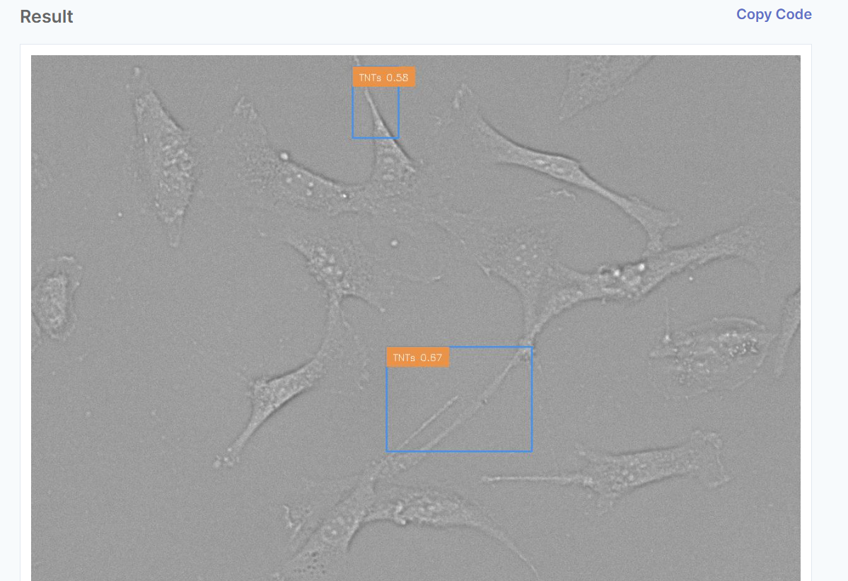
Interface

Slide 25
Future prospects
3D Imaging
Consider acquiring three-dimensional (3D) image stacks to capture the spatial arrangement of TNTs in the cellular environment. This can aid in distinguishing TNTs from other cellular structures.
Integration with Multi-Omics Data:
ML can be applied to integrate data from various sources, such as genomics, proteomics, and transcriptomics, along with TNT data. This holistic approach may uncover complex relationships between tunneling nanotubes and the overall cellular environment.
Correlation with Disease States:
Investigating the presence and behavior of tunneling nanotubes in the context of neurodegenerative diseases or other neurological disorders may offer insights into disease mechanisms. ML models could aid in correlating TNT characteristics with different disease states, potentially leading to the discovery of novel biomarkers.

Slide 26
Links
Datasets
https://docs.google.com/spreadsheets/d/1pPA4NlldlXaiKLhI9zP1ozEfynsJ6gLKK6cJR0SisEU/edit#gid=1722133020 : Circularity and Compactness model dataset (brain cells)
https://docs.google.com/spreadsheets/d/1hKDyh_g_aEhWJCAPLjyu-lmPi7Ei_U_q/edit#gid=88856616 : Circularity and Compactness model dataset (breast cancer spheroids)
https://colab.research.google.com/drive/1EkgVLDNqzGoPOQXul47mQYZWdU0Ym92n#scrollTo=WrtfWehVeBLy : TNT Dataset (Augmented Images)
https://detect.roboflow.com/?model=tnt-quantification&version=1&api_key=w38PBS2XCexTesAo42U5 : Interface

Slide 27
Resources
https://pubmed.ncbi.nlm.nih.gov/36230881/
https://pubmed.ncbi.nlm.nih.gov/32882515/#:~:text=Ionizing%20Radiation%20Treatment-,Tunneling%20Nanotubes%20Mediate%20Adaptation%20of%20Glioblastoma%20Cells%20to%20Temozolomide%20and,iScience
https://ij.imjoy.io/
https://www.ncbi.nlm.nih.gov/pmc/articles/PMC5708080/
https://www.geeksforgeeks.org/residual-networks-resnet-deep-learning/
https://github.com/spraphul/Object-Detection-using-Resnet18-
https://medium.com/analytics-vidhya/resnet-understand-and-implement-from-scratch-d0eb9725e0db

Slide 28
Thanks

